Slide 1
Relative roles of moistening and circumnavigating waves on the MJO propagation during DYNAMO
Xingchao Chen and Fuqing Zhang

Slide 2
Hypotheses explaining the mechanisms through which the onset and propagation of convection occurs over the Indian Ocean include:
Circumnavigating theory: circumnavigating upper tropospheric velocity potential and zonal wind anomalies occurring as a Kelvin wave response to a previous MJO may trigger the next MJO (e.g., Knutson and Weickmann, 1987)
Discharge-recharge theory: humidity gradually increase in the lower to middle troposphere (cumulus clouds re-conditioning, 10 to 15 days prior to MJO onset), and a new MJO cycle commences once the atmosphere becomes sufficiently unstable and moist to support deep convection again (e.g., Blade and Hartmann, 1993)

Slide 3
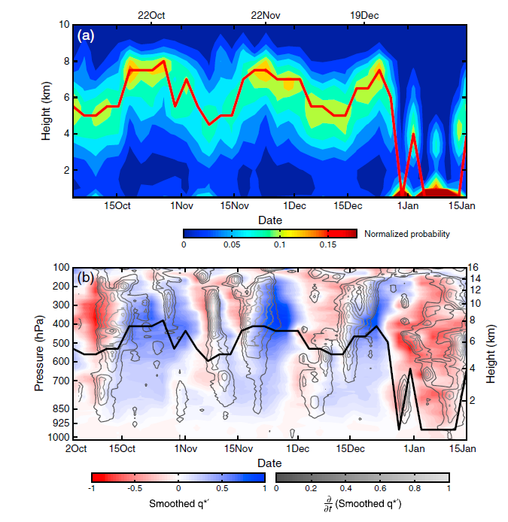
Echo Top probability
Fractional difference of humidity
Powell and Houze, 2013

Slide 4
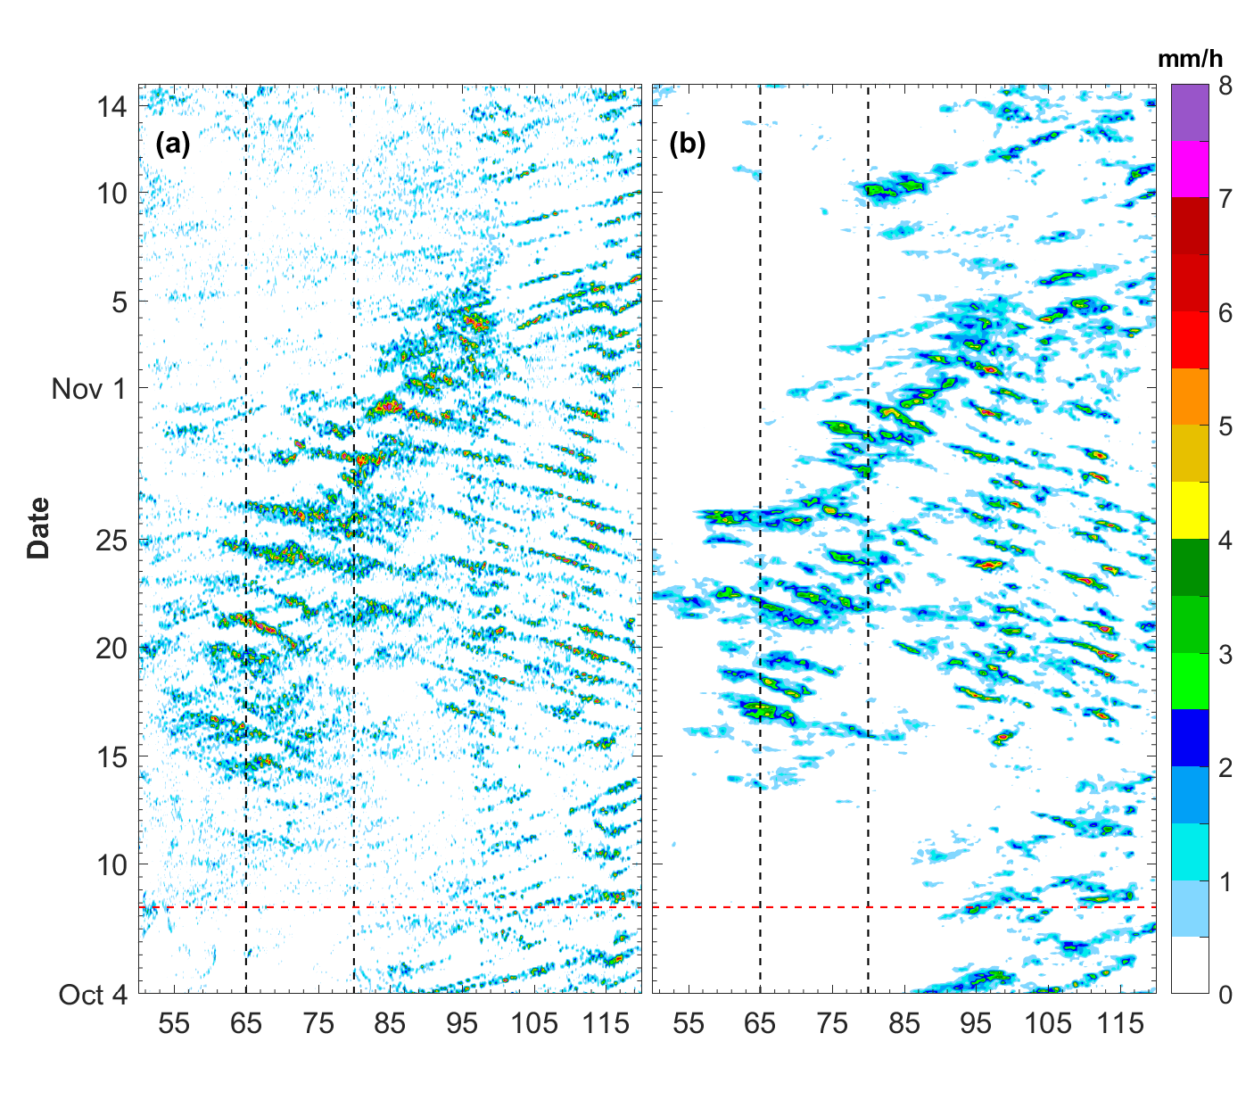
CNTL
TRMM
Precipitation
RH

Slide 5
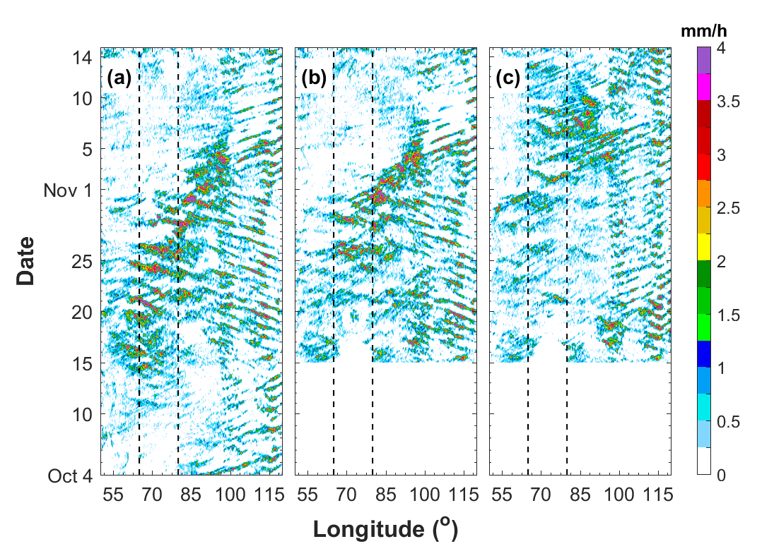
Rainfall
CNTL
DRY
DRY_noMJO

Slide 6
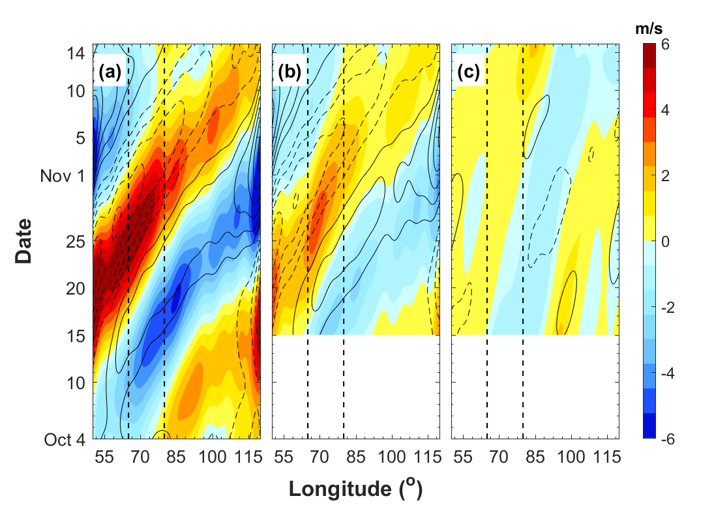
MJO-filtered U wind
CNTL
DRY
DRY_noMJO

Slide 7
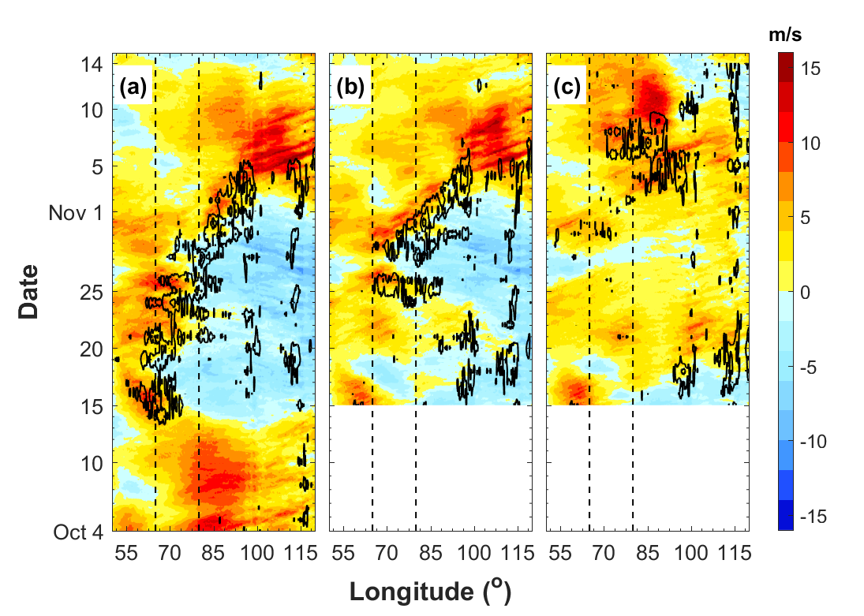
850 hPa U wind
CNTL
DRY
DRY_noMJO

Slide 8
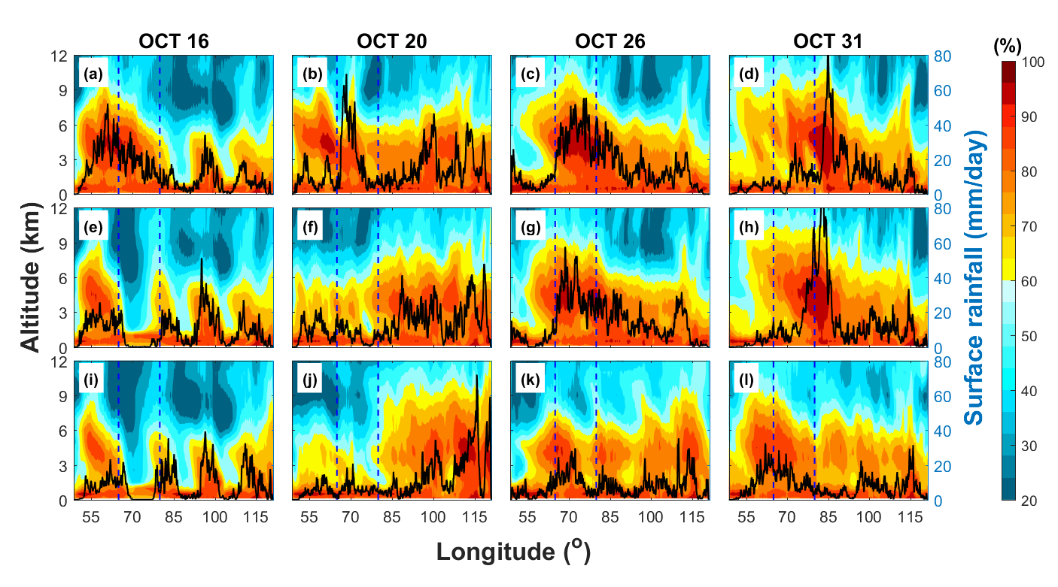
Relative Humidity
CNTL
DRY
DRY_noMJO

Slide 9
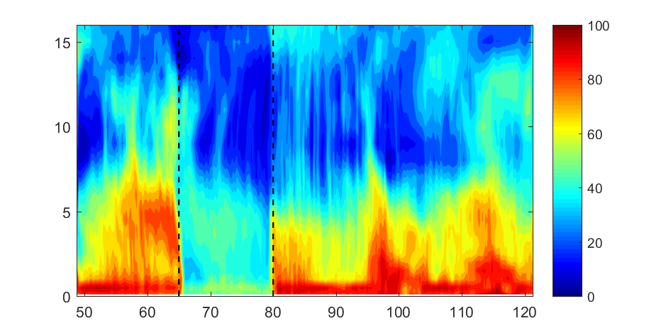
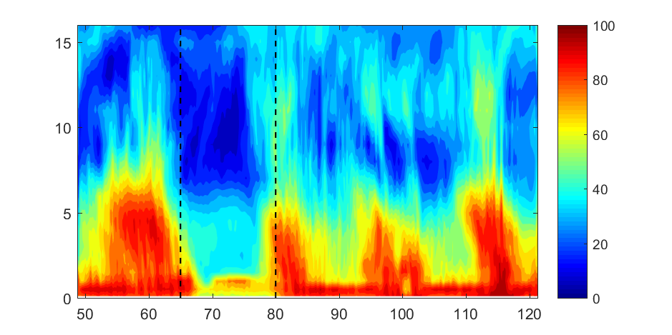
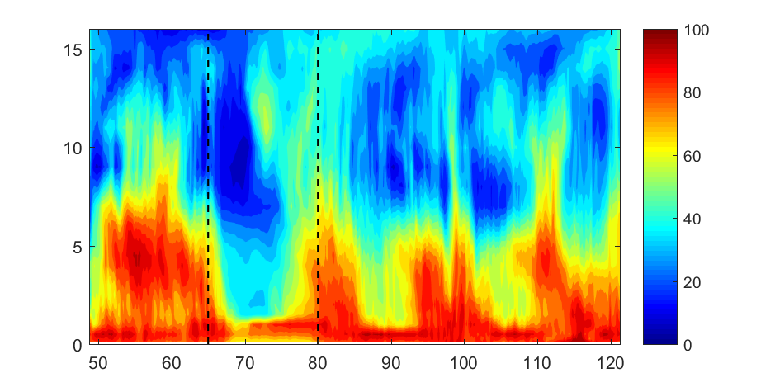
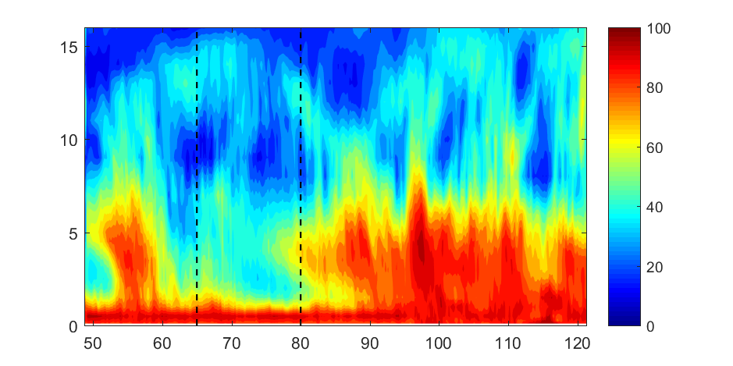
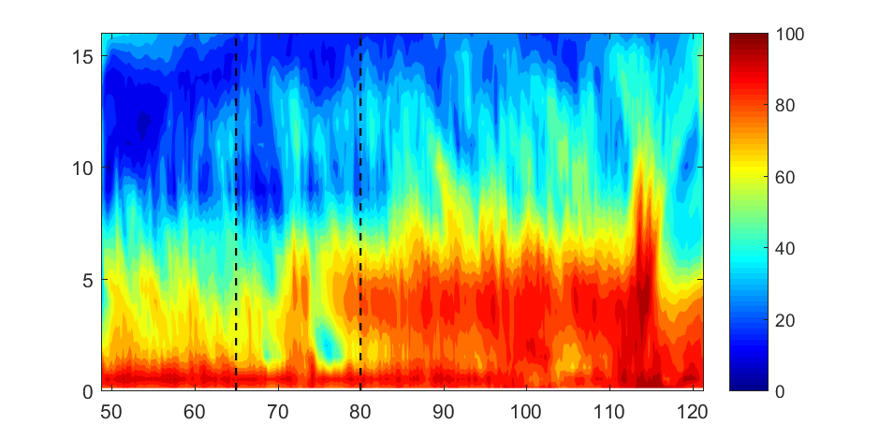
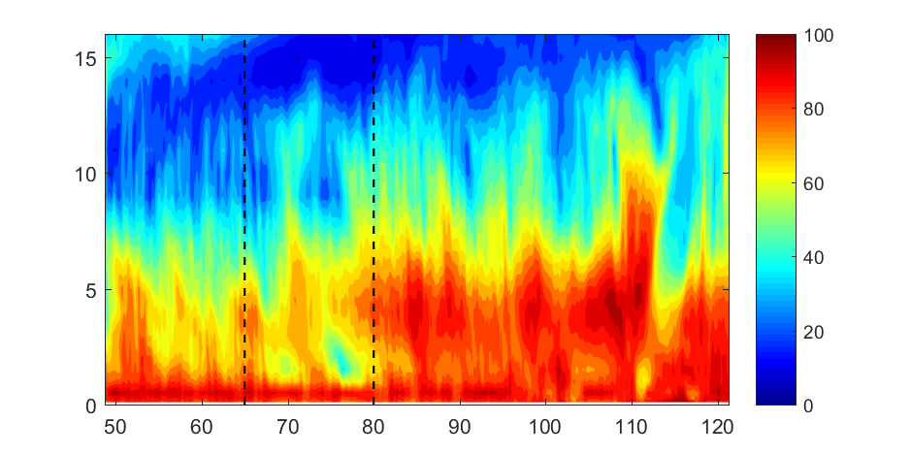
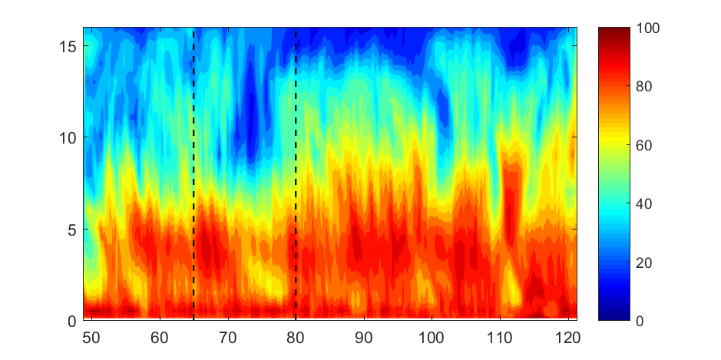
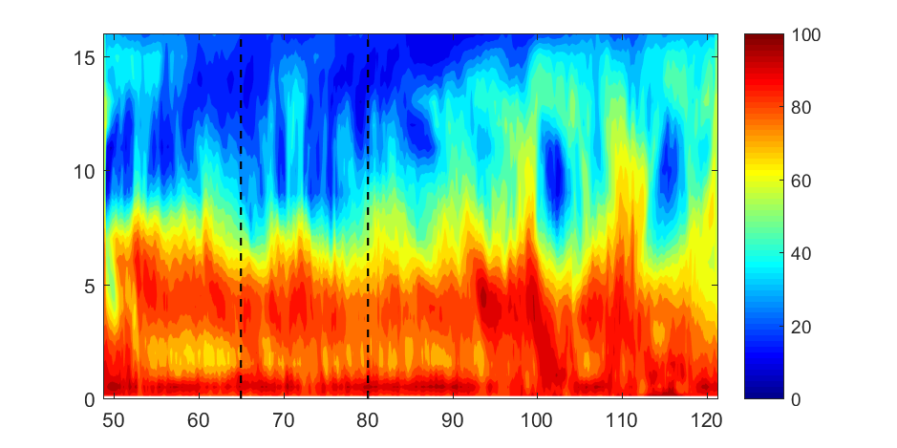
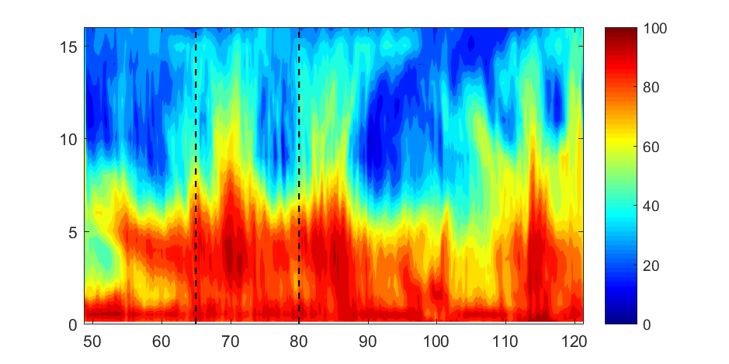
DRY
00 UTC/OCT 15
12 UTC/OCT 15
00 UTC/OCT 16
00 UTC/OCT 18
12 UTC/OCT 19
00 UTC/OCT 20
00 UTC/OCT 21
00 UTC/OCT 23
12 UTC/OCT 25

Slide 10
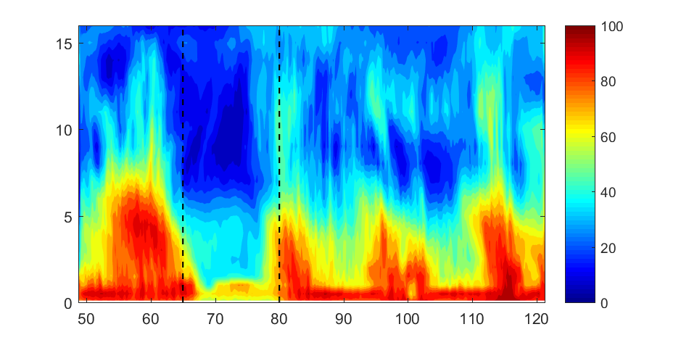
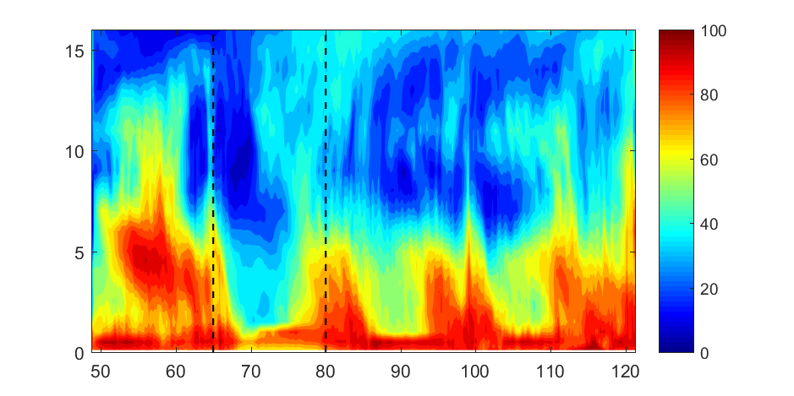
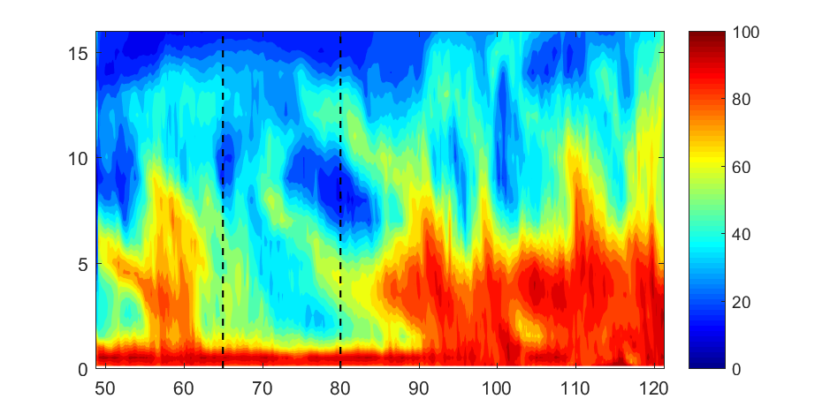
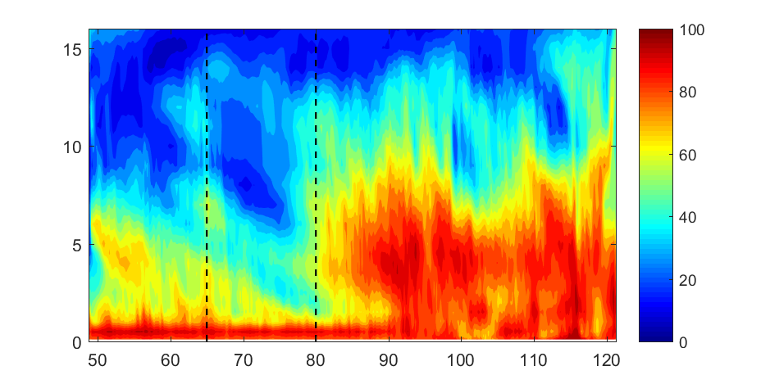
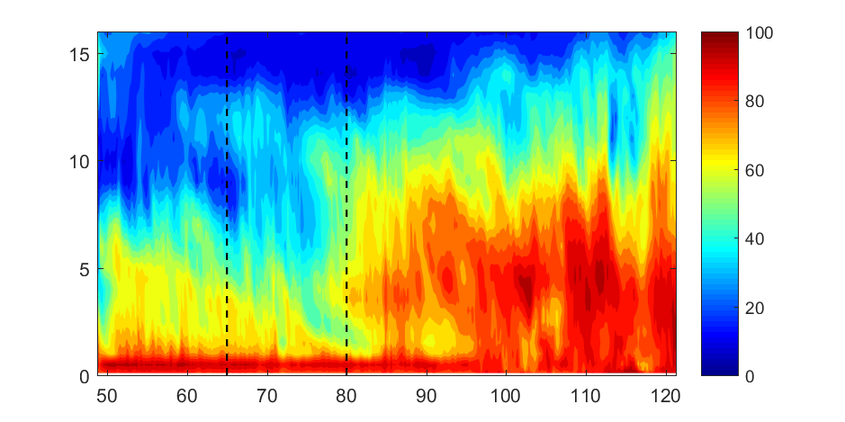
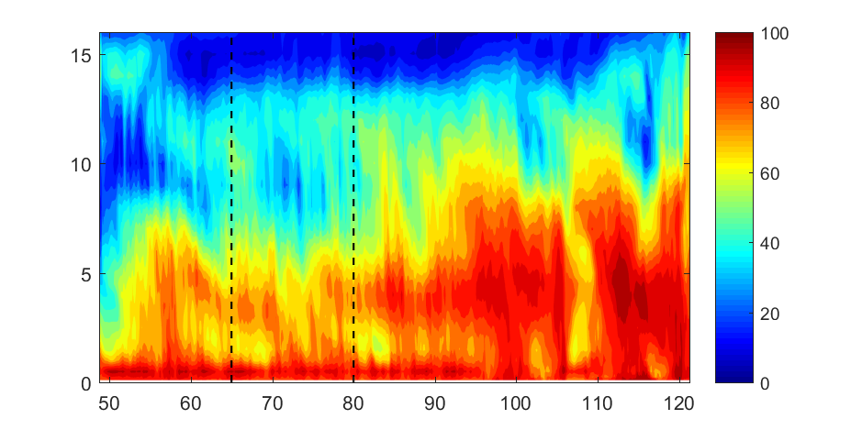
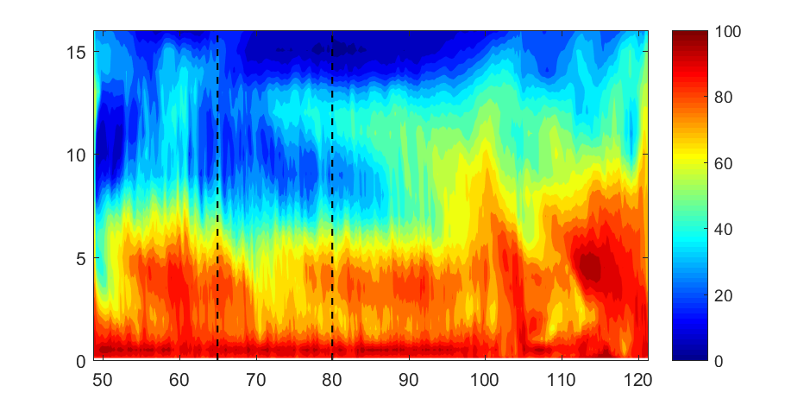
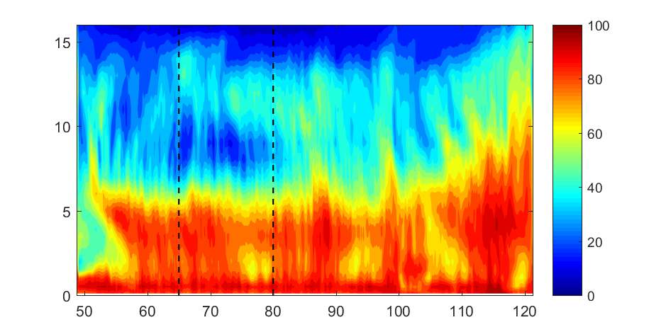
DRY_noMJO
00 UTC/OCT 15
12 UTC/OCT 15
00 UTC/OCT 16
00 UTC/OCT 18
12 UTC/OCT 19
00 UTC/OCT 20
00 UTC/OCT 21
00 UTC/OCT 23
12 UTC/OCT 25

Slide 11
Conclusions：
The eastward propagation of the MJO is dominated by the global circumnavigating waves.
The moistening by moderate convection before the MJO active phase is important to the MJO amplitude.
Future work:
The impacts of moisture transportation on the MJO event

Slide 12
FV3 surface flux
WRF option 2:
$$z_{0}=max⁡\{1.27×{10}^{−7}, \min{[z_{w}z_{2}+\left(1−z_{w}\right)z_{1},2.85×{10}^{−3}]}\}$$
$$z_{w}=\min\left(1,{\left[\frac{u_{∗}}{1.06}\right]}^{0.3}\right)$$
$$z_{1}=0.011\frac{{u_{∗}^{}}^{2}}{g}+1.59×{10}^{−5}$$
$$z_{2}=\frac{10}{exp⁡(9.5{u_{∗}^{}}^{−1/3})}+\frac{1.65×{10}^{−6}}{max⁡(u_{∗},0.01)}$$
Green and Zhang:
$z_{0}=\left\{\begin{aligned}z_{0}, z_{0}≤2.85×{10}^{−3} \\ a\left(z_{0}−2.85×{10}^{−3}\right)+2.85×{10}^{−3}, z_{0}≥2.85×{10}^{−3}\end{aligned}\right.$
$a :$ $the multiplicative parameter we changed in the FV3 sensitivity experiments$
Experiments : a=0.5 (same as Green and Zhang 2013), a=1.0, a=-0.1
The roughness length of temperature and humidity (Brutsaert, 1982)
$$ln\frac{z_{0}}{z_{q}}=b_{1}{{Re}_{∗}}^{1/4}+b_{2}$$
$$z_{q}=z_{t}$$

Slide 13
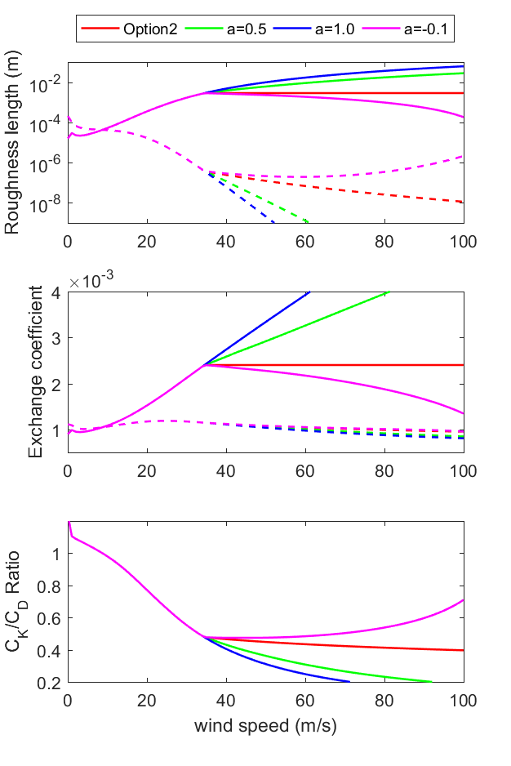
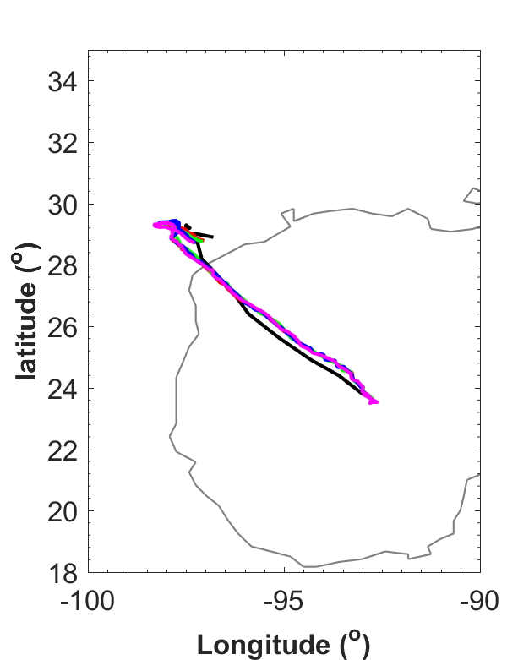
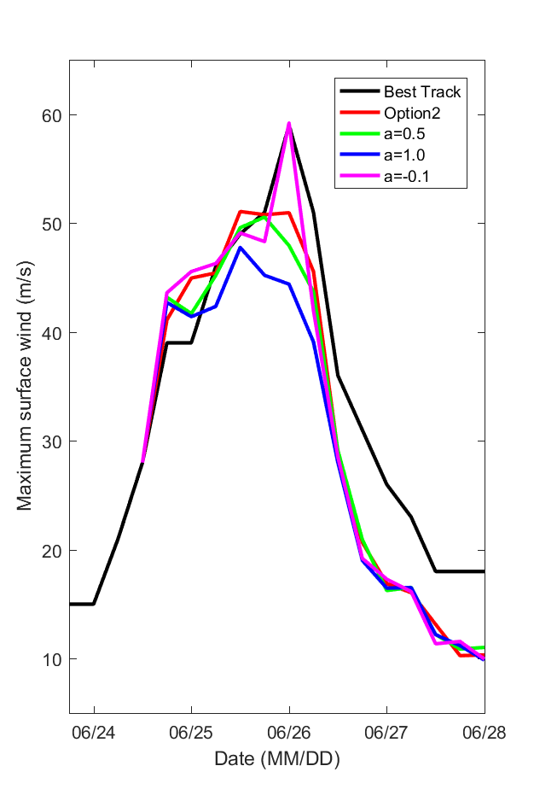
FV3 surface flux

